Slide 1
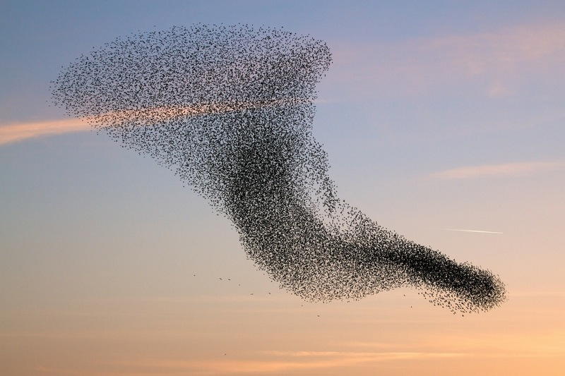
Take home 1: OO Bird Swarm modelling
Dr. Benjamin Campforts
Niels Souverijns

Slide 2
OO Bird Swarm modelling Goal
develop a model to simulate bird warms using the object oriented programming paradigm

Slide 3
Implementation
General rules: see document on Toledo Page or http://www.red3d.com/cwr/https://www.macs.hw.ac.uk/~dwcorne/Teaching/Boids%20Pseudocode.htm
General rules are described by Reynold :
Craig W. Reynold's home page: http://www.red3d.com/cwr/

Slide 4
Your task: make an object oriented program, capable to simulate boids
Think First, Code Later:
Take a sheet of paper, draw the structure
classes, properties, methods
subclasses
Implement the general structure
Classes
Subclasses
Make objects of the class
Test while coding (i.e., write a method, test it for an object)

Slide 5
Your program, your way ? Minimum requirements
3 Classes:
Geometry
Provide properties and required methods to make a cube (the space in which the birds will fly)
Provide properties and required methods to make a sphere (the space in which the birds will fly)
Bird
Provide properties and methods for the ‘basic’ flying rules
Provide properties and methods for the ‘Advanced’ flying rules (see next slide)
Predator (inherits from Bird class)
Provide properties and methods for the basic predator rules and the birds responses
https://www.youtube.com/watch?v=b8eZJnbDHIg
NOTE: green = extra, blue is basic

Slide 6
Your program, your way!
Make use of encapsulation:
write getters and setters to get access to (all) properties of your objects
Decide by yourself which properties should be public, private, dependent
Try to minimize the amount of public properties
Use at least one dependent property
Overload default constructors but make sure you can still use the default constructors.

Slide 7
Your program, your way!
One main script
Make an instance of the geometry
For the cube: vertices are 630 m subtracted with the sum of the numbers in your birthday (e.g. 01.01.96 ➔ 630-98 =532 m).
Make the size of the cube sides (the facets) a dependent property (depending on the property: birthday and the publicly visible property DimNumber).
For the sphere, the diameter has the dimension of 630 subtracted with the sum of the numbers in your birthday (e.g. 01.01.96 ➔ 630-98 =532 m)
Make the size of the sphere diameter(the facets) a dependent property (depending on the property: birthday and the publicly visible property DimNumber)
Make 230 objects subtracted with the sum of the numbers in your birthday (e.g. 01.01.96 ➔ 230-98 =132 birds of the class Bird). Make the number of Bird objects (i.e. birds) a dependent property (depending on the property: birthday and the publicly settable and gettable property BirdNumber)
Let the birds fly
Without a predator (Make sure your program is fully operational)
With a predator (scattering behavior)

Slide 8
Your program, your way!
Use the object oriented paradigm throughout your entire code:
No separate functions
Functions should be part of a class, implemented as a method, or, if required, as helper sub-functions
Think wisely on the attribute types of your class properties (Constant, private, protected, public,…)
Make use of setters to set the input values for your properties and to control user input.
E.g control the range of accepted flying velocity values by using a while structure until the user enters a bird speed which is within an acceptable range.
Can you think of a useful way to have protected/private methods in your solution?
Use good coding practice to make your code more ‘readable’:
E.g. In case you call a constant (in a setter) which is not specific to an instance of a class, call the constant as className.constant rather than objectName.constant

Slide 9
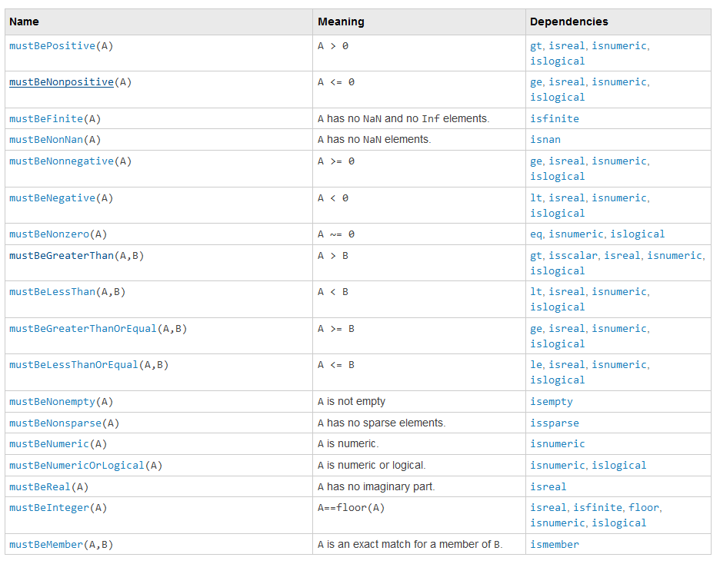
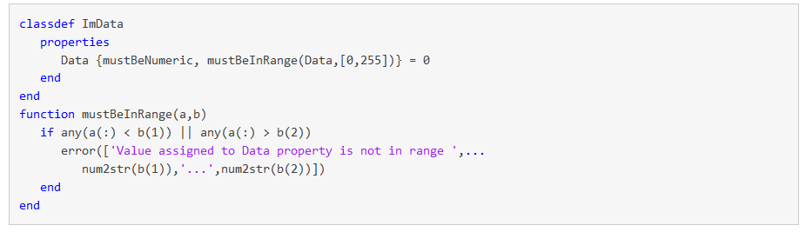
Your program, your way! Property Validation Functions
For every public property, provide a property validation function
Use the predefined property validation functions where possible.
Create your own ones where needed

Slide 10
Somewhat more detail: The class Bird
Overload the default constructor:
Initialize birds at random initial positions (within the object of the class Geometry)
The rules (Reynold’s rules)
Rule 1: Boids try to fly towards the center of mass of neighboring boids
Rule 2: Boids try to keep a small distance away from other objects
Rule 3: Boids try to match velocity with near boids
Bounding the position: keep the birds within the Geometry
! Do not use a fixed distance, use the same method as Rule 2: let the birds move as far away from the edge of the box as it already is!
Limiting the speed (test which speed limitation works for your own geometry)
Tendency away from a particular place: introduce a predator
Create a subclass predator inheriting from Bird

Slide 11
Bird Swarm: guidelines
Additional rules:
Action of a strong wind or current
Tendency towards a particular place
Perching
https://www.youtube.com/watch?v=rwIM2pWFH5k
Additional properties of the birds:
give all the birds a name randomly from the names of your colleagues
Can you figure out how to add a ‘pause’ button on the simulation window and display the name and the current location of all the birds?
Keep track of the total distance and elevation covered by each bird instance. How does the birds rank at the end of your simulation?

Slide 12
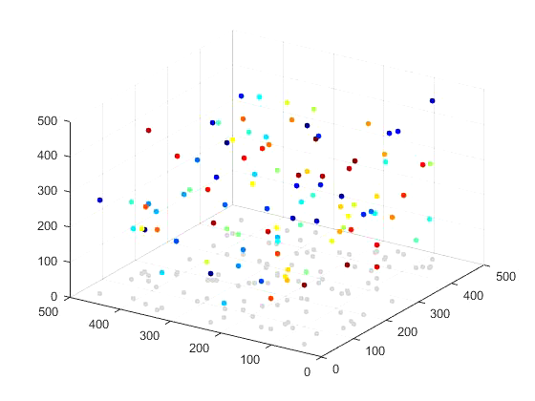
Validation: Geometry=Cube, no predator

Slide 13
Evaluation
Deadline: May, 22 24h
Stick to the deadline, late submissions will be penalized
Submit through Toledo (Assignments)
Exercise will be discussed during the oral exam
DOCUMENT your code
make sure to add comments, extra information where needed
➔ make your code readable (!!)
This is an individual task; we will use plagiarism detection software to check your submission.
Hint: use the discussion board (bonus points)

Slide 14
Hints
First perform all calculations
Only after calculations are done, do the visuals
The shade in the movie can be obtained by projecting the birds to the ground plane (z = 0 m).

Slide 15
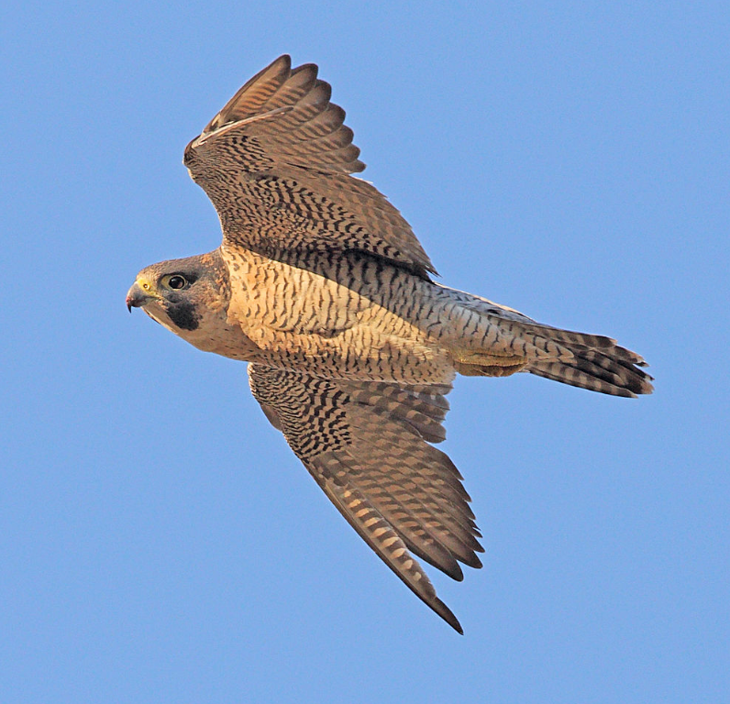
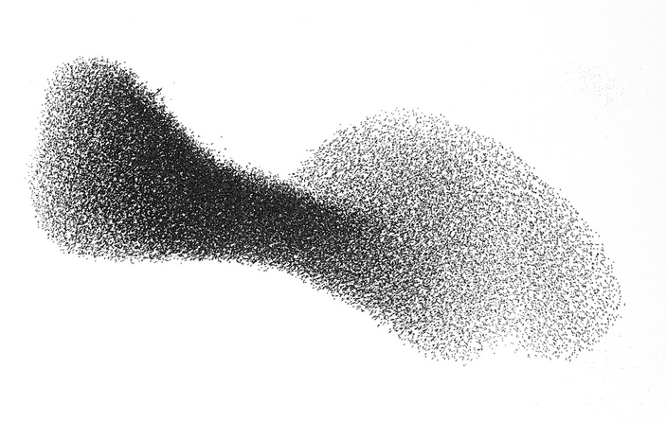
Challenges
Google.com

Slide 16
Challenges
The falcon challenge
Find the correct answer in the shortest computation time
Grading +2
The swarm challenge
Show off your OO programming skills and write the piece of code which best represents the OO program paradigm
Grading +2

Slide 17
Timeframe
April 2nd: Mid-term evaluation of your own project. We reserve 5-10 minutes per student to :
Discuss your program lay-out
You bring a written(!) plan where you present the architecture of your program
Hint at potential improvements in the source code as you have it by then
Not mandatory but:
➔ the more you have done by April 2nd , the more helpful your feedback will be

